Slide 1
NutriClass – Food Classification Using Nutritional Data Machine Learning | Nutrition Informatics
By Arjun

Slide 2
Problem Statement
In the era of increasing dietary awareness, the ability to classify food items based on nutritional attributes are invaluable. This project involves developing a machine learning model that classifies food into multiple categories using tabular data such as calories, proteins, carbohydrates, fats, and sugar. By the end of this project, we will be able to create a robust classification system that can accurately label food types and gain insights into what makes each food category distinct. management systems.

Slide 3
Objective Build a multi-class classification system that predicts food type using features like:
Calories
Protein
Fat
Carbohydrates
Sugar
Dietary tags (Vegan, Gluten-Free)
Preparation & Meal type
Dataset Overview
File Name: synthetic_food_dataset_imbalanced.csv Shape: 31,700 rows × 16 columns Target: Food_Name (encoded into Label) Issue: Highly imbalanced food classes

Slide 4
Data Cleaning
Dropped 313 duplicate records
Removed 375 missing values from each numeric column
Converted Is_Vegan, Is_Gluten_Free to integers
Encoded Meal_Type and Preparation_Method using one-hot encoding
Encoded Food_Name with Label Encoding for classification
Feature Engineering
Applied StandardScaler to normalize features
Used PCA (n_components = 0.95) for dimensionality reduction
Performed SMOTE to balance imbalanced classes
Final feature set → ~19 columns reduced to optimal PCA components

Slide 5
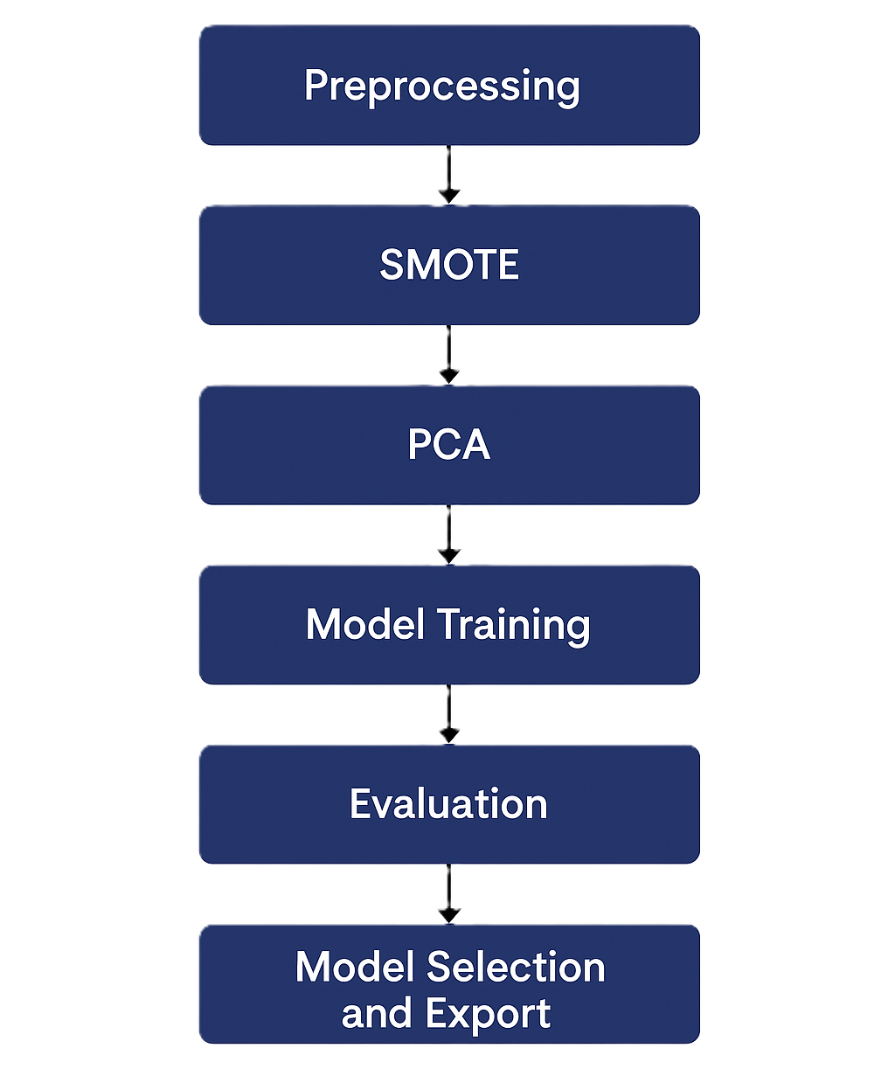
Model Pipeline
Preprocessing (Clean → Encode → Scale)
Oversampling with SMOTE
Dimensionality Reduction (PCA)
Model Training via RandomizedSearchCV
Evaluation with Accuracy, Precision, Recall, F1-Score
Model Selection and Export

Slide 6
Models Used
Models | Hyperparameter Tuning
Logistic Regression | C values
Decision Tree | Max_depth, criterion
Random Forest | N_estimators, depth
K-Nearest Neighbors | N_neighbors
Support Vector Machine | C, kernel
XGBoost | Learning_rate, trees
Gradient Boosting | Learning_rate, trees

Slide 7
Evaluation Metrics
Metric | Used To Measure
Accuracy | Overall correctness
Precision | Class-specific relevance
Recall | Class-specific completeness
F1-Score | Balance between Precision/Recall
Confusion Matrix | Error Analysis
Macro average used due to class imbalance.
20% test set used with Stratified Split

Slide 8
Model Performance Summary
Model | Accuracy | Precision | Recall | F1 Score
Support Vector Machine | 98.9% | 99.0% | 99.0% | 99.0%
Gradient Boosting | 98.8% | 99.0% | 99.0% | 99.0%
Random Forest | 98.8% | 98.9% | 98.9% | 98.9%
K-Nearest Neighbors | 98.7% | 98.7% | 98.8% | 98.8%
XGBoost | 98.7% | 98.9% | 98.8% | 98.9%
Logistic Regression | 98.6% | 98.9% | 98.9% | 98.9%
Decision Tree | 97.9% | 97.9% | 98.0% | 98.0%

Slide 9
Streamlit App Features
Dataset Overview + Missing Value Count
Model Comparison Table (Accuracy, Precision, Recall, F1)
Interactive Plotly Bar Charts for model metrics
Confusion Matrix (selectable per model)
Downloadable models (.pkl) and preprocessing objects (scaler, pca, label_encoder)

Slide 10
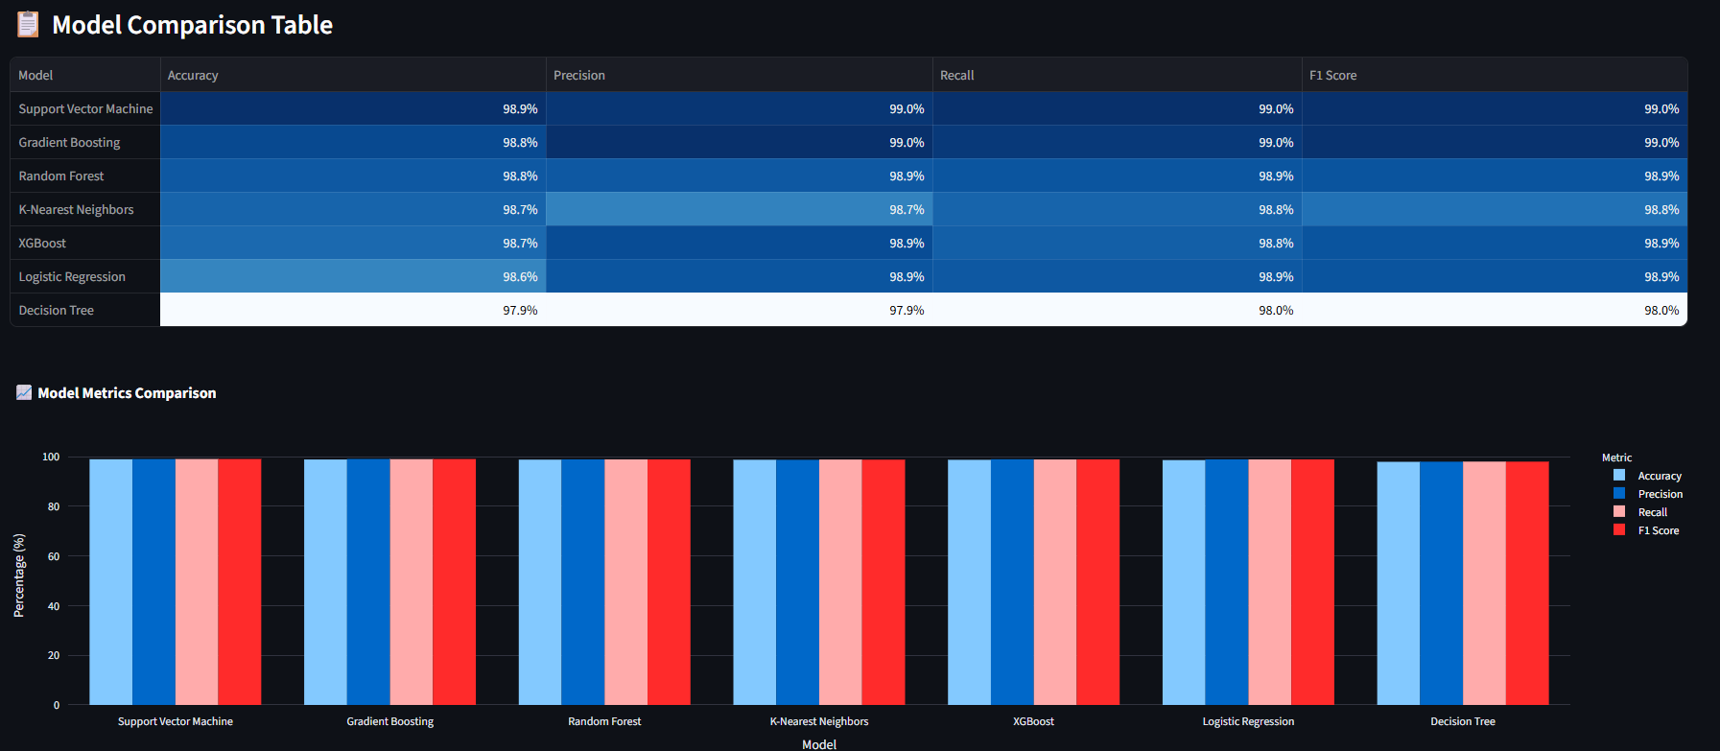
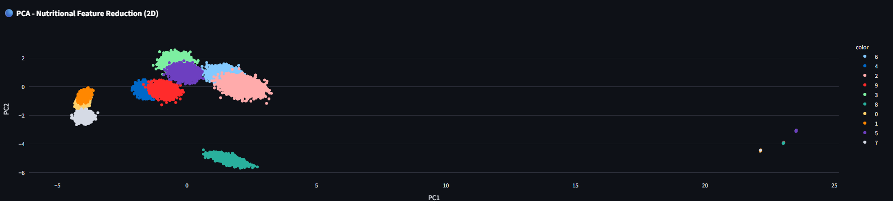
Visual Insights

Slide 11
Conclusion
Data imbalance was effectively tackled using SMOTE.
PCA helped reduce dimensionality without sacrificing performance.
Support Vector Machine outperformed others on all metrics.
Streamlit App provides an interactive visual diagnosis for users.
Future Improvements
Use Deep Learning (ANN or CNN with tabular embeddings).
Add multi-label classification (e.g., classify based on use-case: breakfast, vegan, high protein).
Integrate live food API and image-based classification.
Mobile app or chatbot interface for predictions.

Slide 12
Project Deliverables
Dataset: synthetic_food_dataset_imbalanced.csv
Python Scripts and .pkl files for models
Evaluation Summary: model_results.csv
Streamlit App: NutriClass Visualizer
PPT & Final Report

Slide 13
THANK YOU

